Slide 1
API Developer Training
Introduction

Slide 2
Speaker Introduction
Trainee Student Introduction
Course Introduction
Virtual Class Logistics
What is API?
Different Delivery Model

Slide 3
Introduction

Slide 4






Who am I?
Adolphus Minu

Slide 5
Who am I?
Jeffrey Kwok
Accenture
Solution Architect
Certified DSD
Accenture acquired
Pacificlink and DMA
Joined Accenture

Slide 6
Trainee Introduction….
Let’s get to know each other
Let’s go through the group alphabetically (lastname,A..Z)
You can introduce yourself in audio or in chat box
4 simple questions
Your roles and responsibilities in Generali
E.g. I am the Java developer responsible for maintaining the Policy & Admin System
What is your programming experience ?
E.g. I have 5 years of Java J2EE programming experience. I also am familiar with SQL programming in MS and Oracle DB
What do you want to learn ?
E.g. I want to learn the latest NoSQL database programming for enterprise system
How well do you know online meeting tool (WebEx or Zoom or Teams)
Pls rate 0 (no experience) to 5 (master level) ?

Slide 7
Development Team
Name | Email | Remarks
Kanokporn Ritthiyong (IT - Developer) | kanokpornr@generali.co.th | Developer (Java)
Phiphat Saengsant (IT - Developer) | phiphats@generali.co.th | Key Developer (Java)
Prasit Uantrai (IT - Developer) | PrasitU@generali.co.th | Key Developer (.NET)
Somjet Thanaphakawat (IT - Developer) | somjett@generali.co.th | Key Developer (Java)
Yaowaluk Kaewkitipong (IT - Developer) | yaowalukk@generali.co.th | Key Developer (Java)
Interested in API Testing
Chayanon Wisantanon (Guest) | temp-bpo02@generali.co.th | Only for API testing classes
Chonita Wonglertwatig (BPO - BA) | chonitaw@generali.co.th | Only for API testing classes
Doungkamol Kruasena (Tester) | DoungkamolK@generali.co.th | Only for API testing classes
Prakasit Matrangkul (Guest) | sommanatw@generali.co.th | Only for API testing classes
Pulawat Thongchanda (Tester) | PulawatT@generali.co.th | Only for API testing classes
Sommanat Wongchaichana (Guest) | sommanatw@generali.co.th | Only for API testing classes

Slide 8
Welcome to our student trainee
Development Team
Observer and Interested Party
Kanokporn Ritthiyong (IT - Developer)
Phiphat Saengsant (IT - Developer)
Prasit Uantrai (IT - Developer)
Somjet Thanaphakawat (IT - Developer)
Yaowaluk Kaewkitipong (IT - Developer)
Phanuwat Pattamanakul (IT - Developer)
Thida Techaphalangrak (IT - Head of Developer)
Thongchai Sukosi (IT - PM)
Guests
Interested in API Testing
Pichit Boonuppathum
Siwawes Wongcharoen
Sukasem
Witsarut Hannapachewin
Chonita Wonglertwatig (BPO - BA)
Prakasit Matrangkul (Guest)
Sommanat Wongchaichana (Guest)

Slide 9
Course Logistics

Slide 10
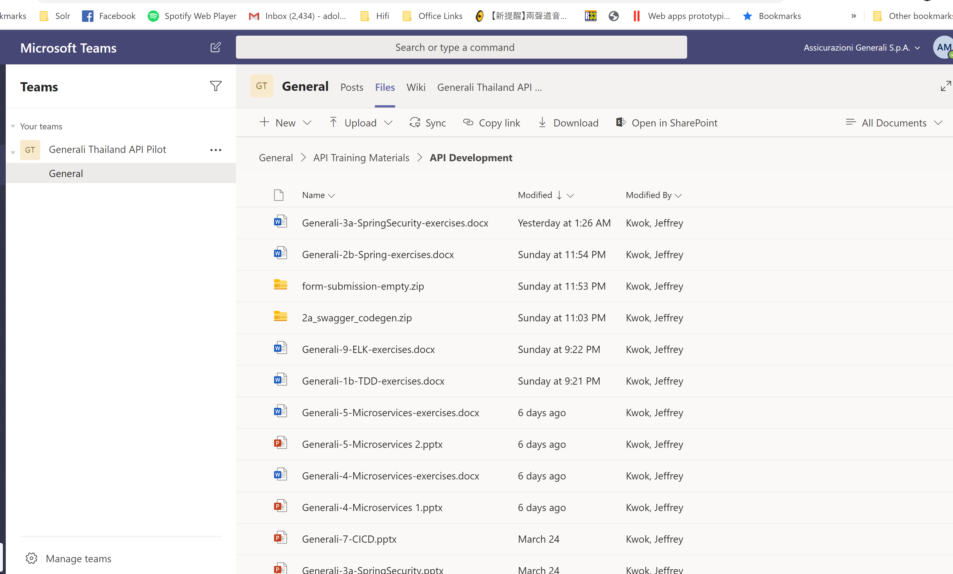
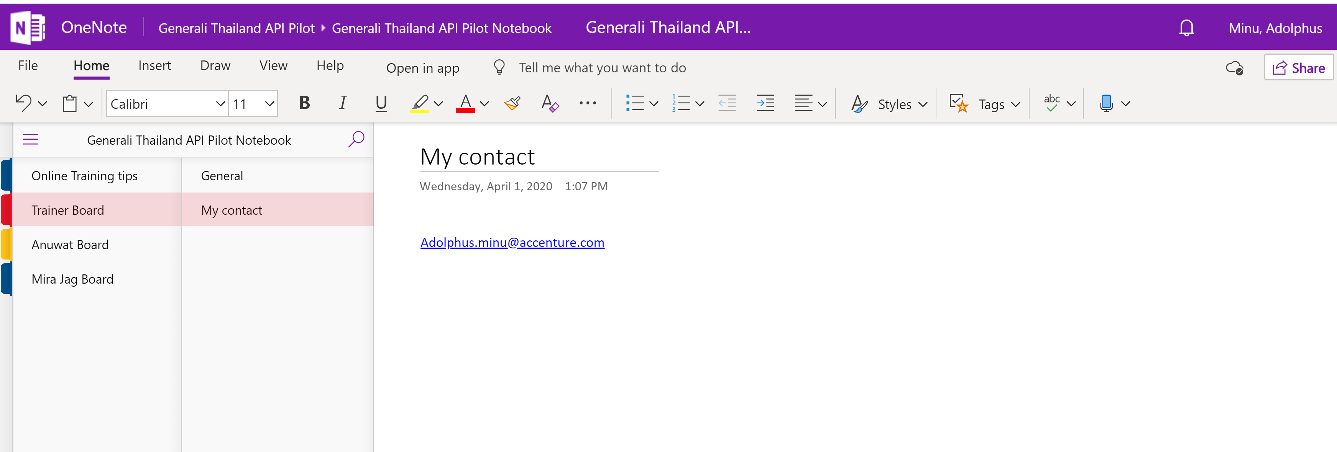
Course Logistics
At the start of training
Login to Online training site (WebEx or Zoom)
Login to MS Teams before the training starts. Trainees will download files, access OneNote notice board there
Do a roll call to take attendance
Show training calendar to recap where we are
Thai local trainer to introduce a bit in Thai about what we plan today

Slide 11
Course Logistics
During training
Trainer to deliver the training
Use “Raise hand” function or type your questions in Chat box
Moderator (Anuwat, Adolphus or other trainer) to support and capture questions in Chat box
Break for 10-15min every hour
Be prepared – You will get frequent direct questions / quiz
Refer to the Teams OneNote board for additional information

Slide 12
Course Introduction

Slide 13
Course Introduction
What is API
Day | Topics
1 | Course Introduction Test Driven Development
2 | Tools, REST, Swagger Spring and Spring Boot
3 | Spring and Spring Boot Maven
4 | Microservice and API Development
5 | Microservice and API Development Introduction of CICD
6 | Test Automation
7 | Application Security Best Practice
8 | ELK Overview
9 | Final Assessment

Slide 14
What is API

Slide 15
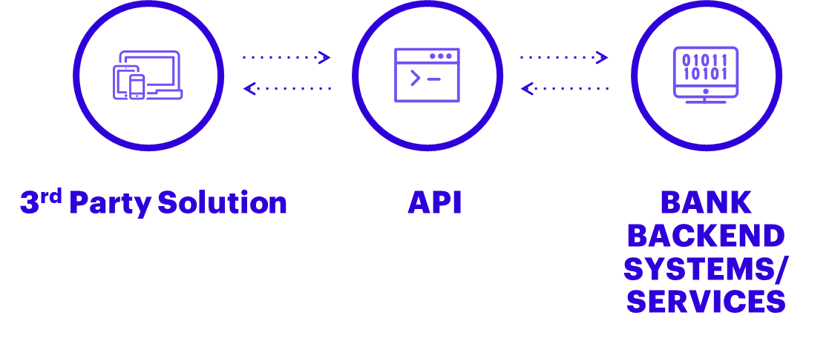
What is API
API Stands for “application programming interface”
API’s are the bridge that make it possible for a product or service to connect with other systems/data sources and create better value
They are used to expose business, data , functionality & services to the outside world and third parties in a controlled fashion.

Slide 16

What is API
Application programming interfaces (API) fuel innovation and speed up implementation
Because of APIs’ common standard, Collaboration & Innovation is simple
With Standardized, reusable APIs Digitalization can be accelerated
APIs can be easily understood and used by internal and external developers and therefore increase interoperability across organization’s borders. This drives collaboration and innovation
APIs allow plug & play connectivity to IT services and make a rapid access to various systems possible – similar to a power socket. This increases implementation speed and lowers development costs

Slide 17
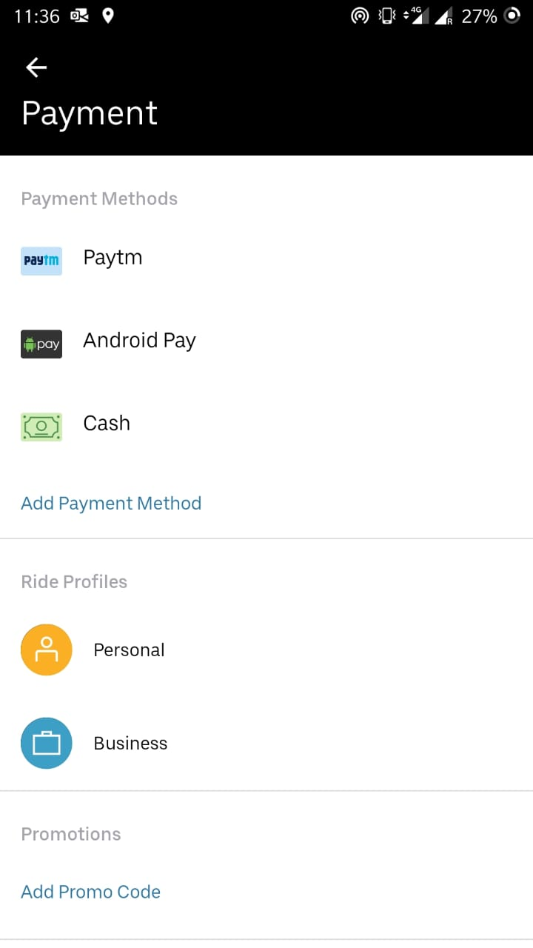
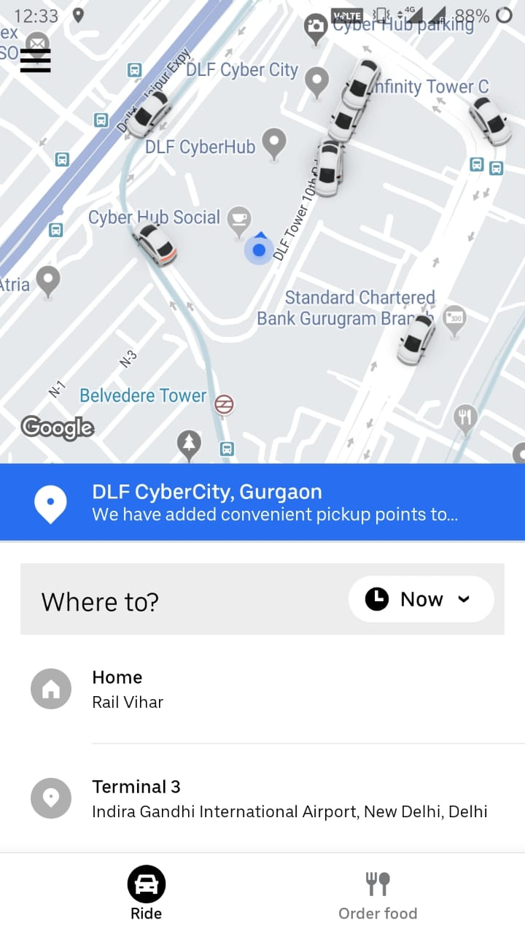
What is API
Example
UBER uses Google maps API for geolocating resources, cars & riders.
It also uses payment API’s from various service providers e.g. Paytm

Slide 18
What is API
Types of API and Typical Usage
Private API
(Integration)
Partner API
(Collaboration)
Open API
(Innovation)
DEGREE OF
OPENNESS
Used internally to facilitate the
integration of different
applications & systems used by a company
Used to facilitate communication
& integration of software between a company and its business and partners
Used to publicly expose
Information to third parties who may not have a business relationship with the company
OFFER ACCESS TO A
USER EXPERIENCE
Salesforce
Netflix
Spotify
Youtube
Facebook
Amazon
1
2
ENABLE DELIVERY OF A
SERVICE OR PRODUCT
Amazon
Walgreens
Skype
Google Maps
3
OFFER ACCESS TO DATA
AT&T
Equifax
Fedex
Paypal

Slide 19
What is the difference between Microservice and API
API
API
API
Microservices can be used to expose one or more APIs
APIs are interfaces
Microservice A
Microservice B
Microservice C
Not all microservices components expose APIs
Microservices are components

Slide 20
Different Delivery Model

Slide 21
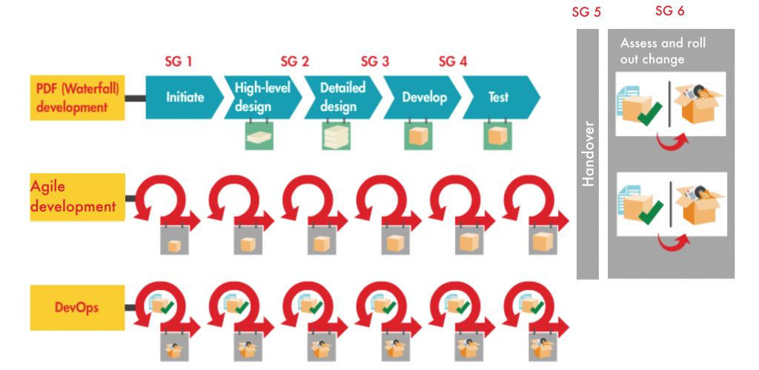
Different Delivery Model
DevOps focus on delivering a minimal viable product (MVP) soonest that delivers tangible business value

Slide 22
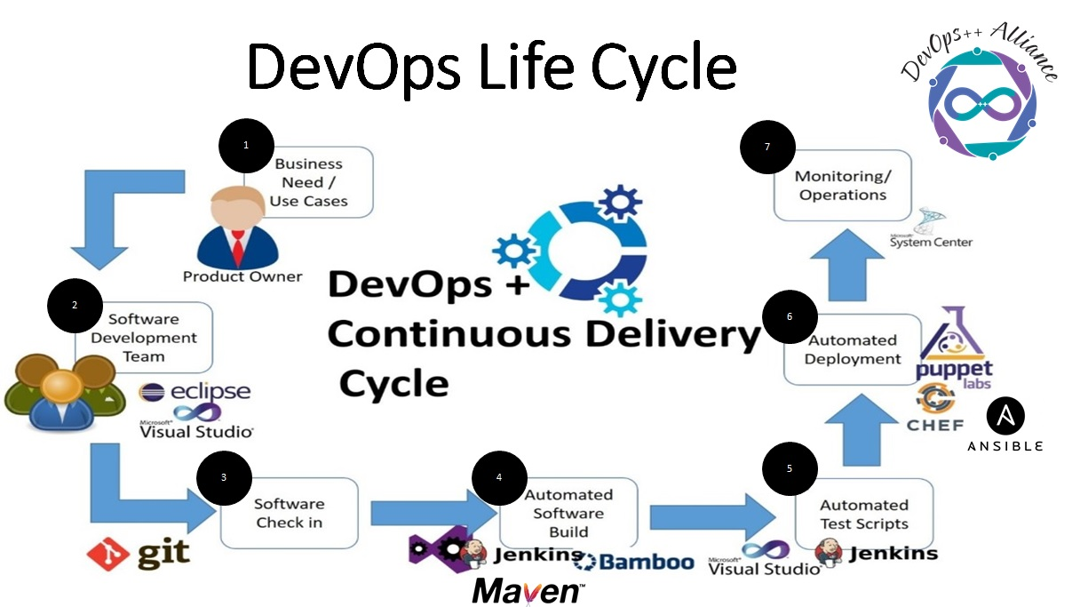
Key responsibilities for developers
Code Management
Program Quality
Documentation

